Slide 1







FINANCIAL ANALYTICS
Created by
Archana G

Slide 2




INTRODUCTION
Without analyzing the competition, it is difficult for a business to survive. You are tasked to analyse the competition for the management to provide better results. This data set has information on the market capitalization of the top 500 companies in India. Serial NumberNameName of CompanyMar Cap – CroreMarket Capitalization in CroresSales Qtr – CroreQuarterly Sale in crores. Find key metrics and factors and show the meaningful relationships between attributes.

Slide 3

Company Names
01
Details of Data
Market Capitalization
02
Quarterly Sales
03

Slide 4




Main KPIs
Average Market Capitalization
Total Market Capitalization
Total Quarterly sales
Average Quarterly sales
Higher quarterly sales of 10 companies(In Cr)
Average Quarterly Sales and Market Capitalization of Companies
Market Capitalization of Top 10 Companies in India(in Cr)
Companies Vs Quarterly sales
Market Capitalization Vs Companies
Market Capitalization Vs Quarterly sales

Slide 5




MY DESIGN
Next slide

Slide 6

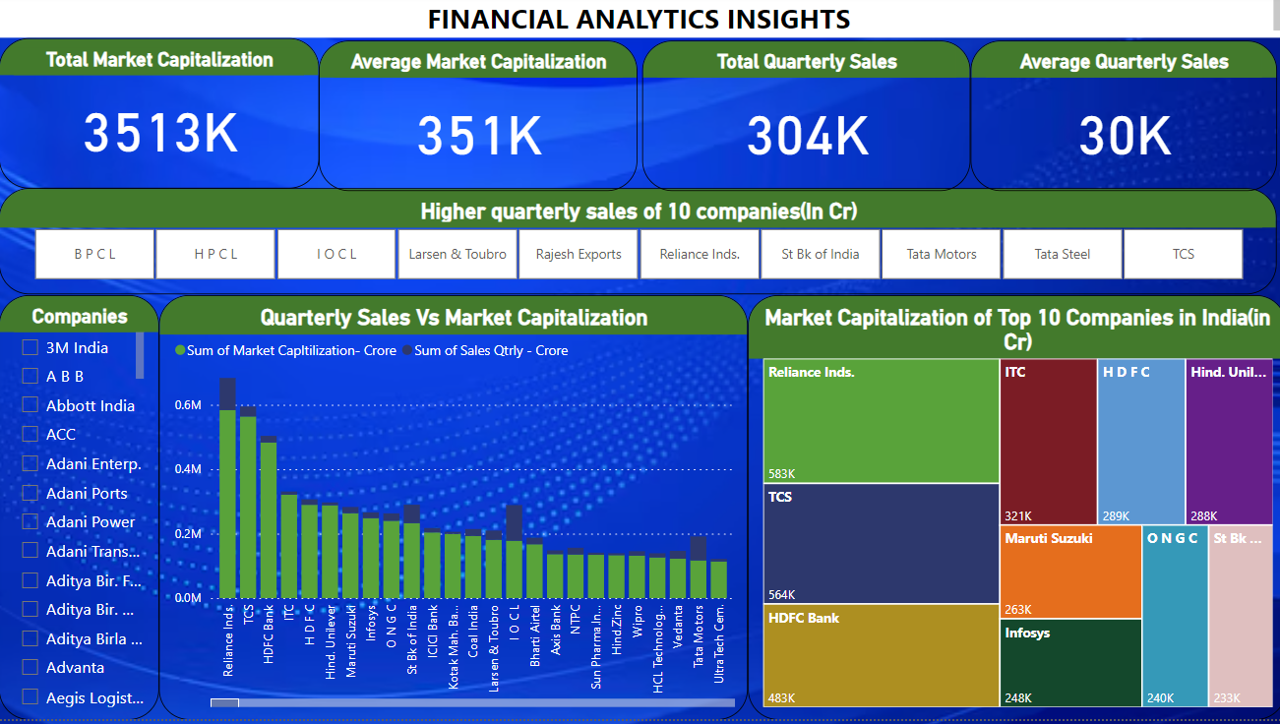


Slide 7
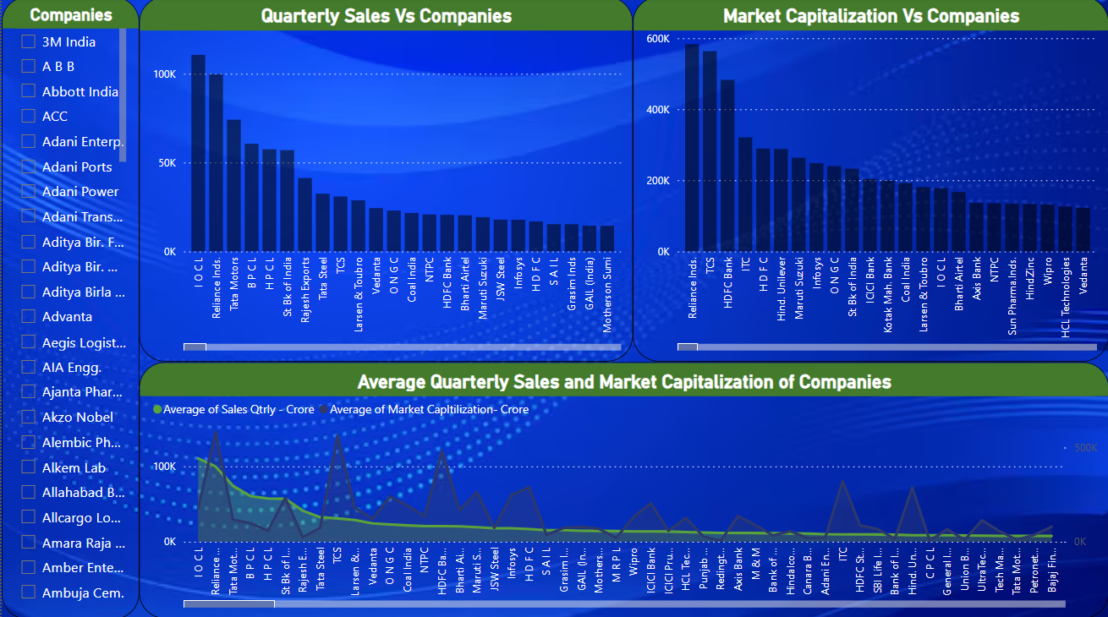

Slide 8






Thank You
Archana G
archanagajendra22@gmail.com

